Slide 1
Acids and Bases
Unit III

Slide 2
Brainstorm: Acids and Bases
Think
Pair
Share

Slide 3
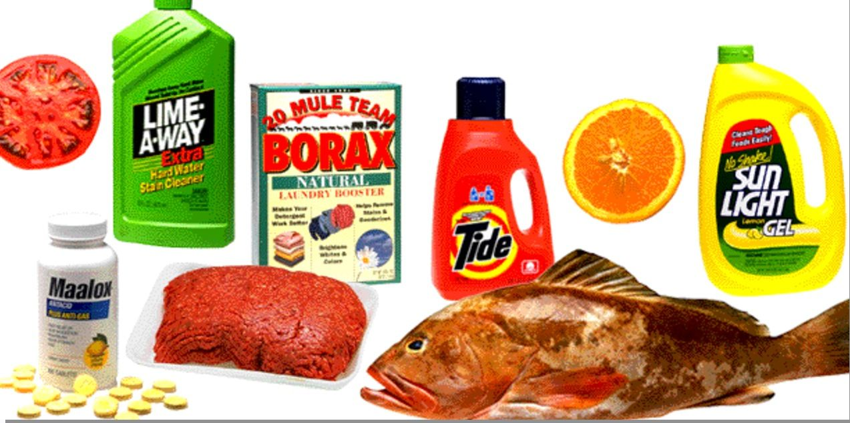

Slide 5
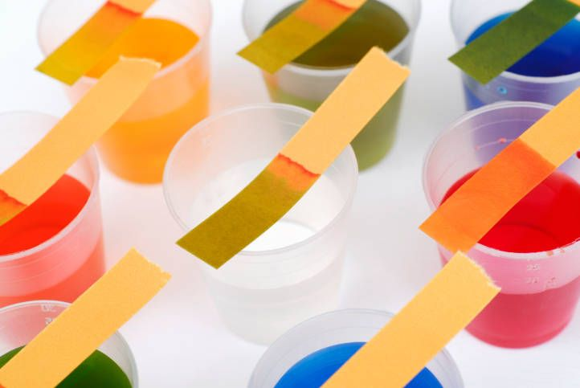

Slide 6
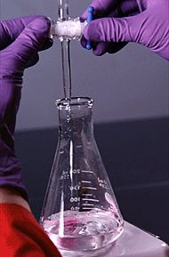

Slide 7
With your group decide whether you agree or disagree with each of the following statements:
BEFORE
AFTER
All acids with the same concentration are the same strength
All bases have “OH” in their chemical formula
The pH scale is a logarithmic scale

Slide 8
Sort the following vocabulary words into groups:
Arrhenius theory Caustic
Titration Sour taste
Logarithms Kw
Strong base Corrosive
Electrolyte Dissociation
Conjugate acid-base pair Bitter taste
Levelling effect Proton
Ka Weak acid
pH Hydrogen ion
Ionization Strong acid
Hydrolysis Bronsted-Lowry theory
Indicators Amphiprotic
Weak base Kb
pOH Slippery
Buffers

