Slide 1
Plate Tectonics
Chapter 12.2

Slide 2
Plate Tectonics Brainstorm
Think
Pair
Share

Slide 3
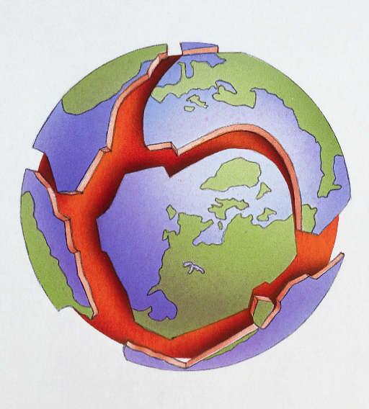

Slide 4
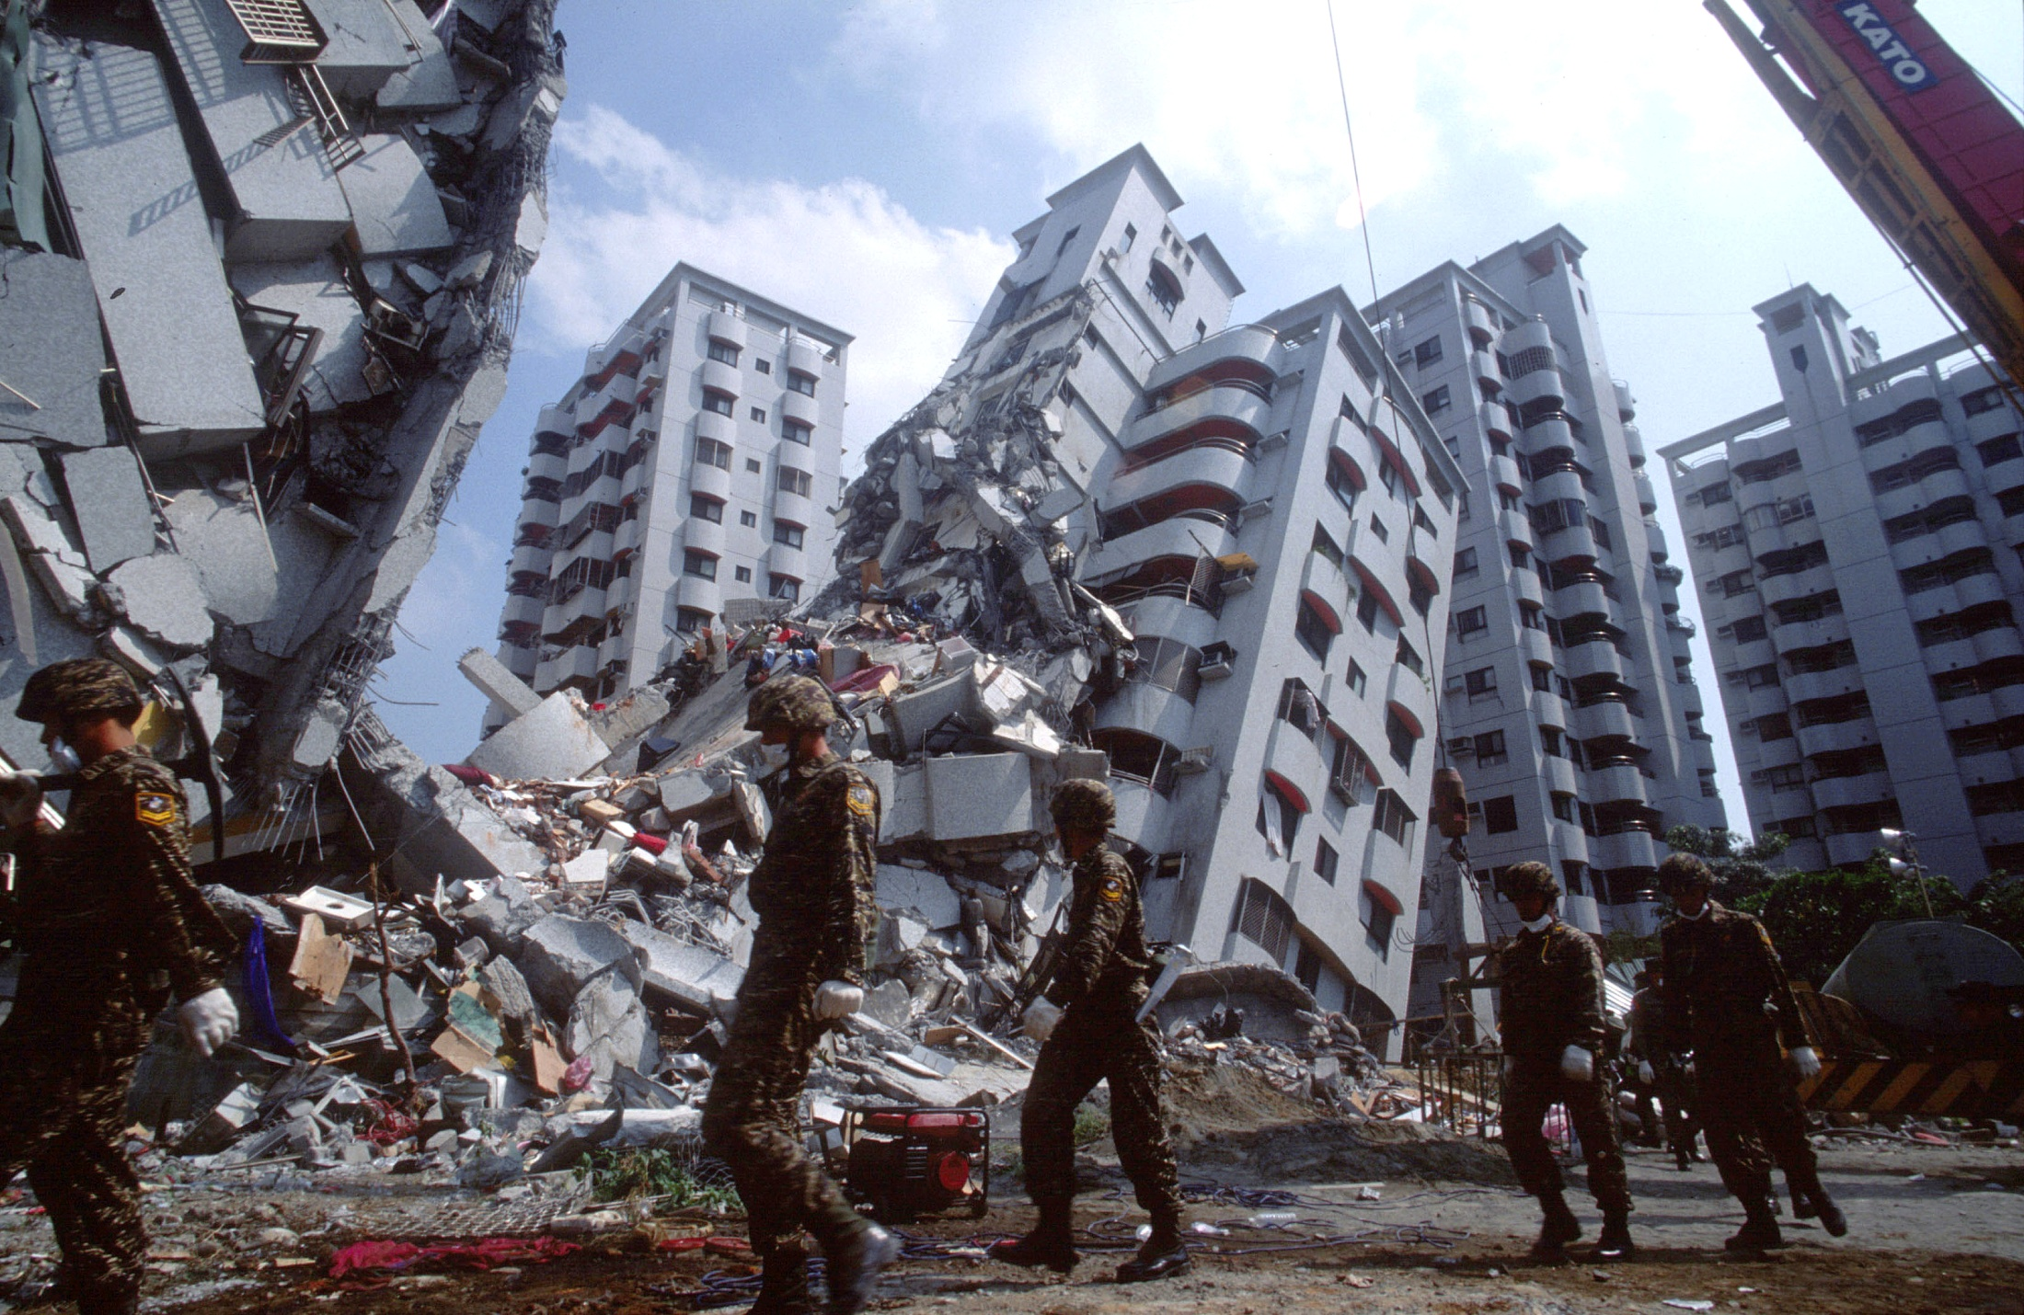

Slide 5
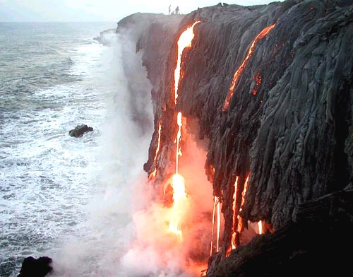

Slide 6
With your group decide whether you agree or disagree with each of the following statements:
BEFORE
AFTER
On average, the Earth’s plates move 2 cm/year. This is the same rate that fingernails grow.
The inner core of the Earth has a temperature between 3000 ºC and 4000 ºC.
The Himalayas mountain range is gradually getting higher.

Slide 7
Sort the following vocabulary words into groups. Then read Section 12.2 in your textbook and re-sort the words if necessary.
earthquakes divergent plate boundary
lithosphere subduction
inner core mantle
continental drift asthenosphere
rift valley mantle convection
subduction zones ridge push
plate boundary outer core
convergent plate boundary oceanic crust
volcanic belt slab pull
continental-continental plate convergence crust
volcanic island arc diverging plates
converging plates oceanic-continental plate convergence
oceanic-oceanic plate convergence seismology
seismic waves trench
magnitude epicenter
composite volcano transform fault
fault primary waves (P-waves)
seismometers focus
secondary waves (S-waves) seismogram
volcanoes rift eruption
surface waves (L-waves) shield volcano

