Slide 1
Quantum Mechanics
Organization of Electrons in Atoms

Slide 2
Electron Configuration - 1
Bohr’s orbitals are not specific paths around the nucleus
Instead they represent regions of space where an electron is likely to be found
SIR Demo of an s orbital

Slide 3
Each energy level is divided into shells
The shells are labelled s, p, d, f
Each shell has a different shape:

Slide 4
Each shell is divided into smaller subshells:
s = 1 subshell
p = 3 subshells
d = 5 subshells
f = 7 subshells
Each subshell can hold a maximum of two electrons so:
s = 2 electrons
p = 6 electrons
d = 10 electrons
f = 14 electrons

Slide 5
http://www.youtube.com/watch?v=frBsMTA-eS8
The first energy level has only an s shell
The second energy level has an s and a p shell
The third energy level has s, p, and d shells
The fourth and higher levels have s, p, d, and f shells

Slide 6
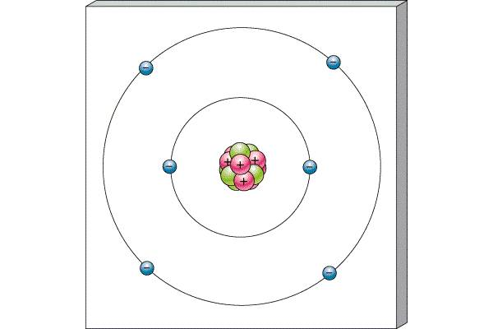
For example, Carbon
Bohr:
Quantum Mechanics:
1s²2s²2p²

Slide 7
Electron configuration of an atom is found by organizing electrons from the orbital with the lowest energy to the orbital with the highest energy (called the Aufbau principle)
Start with the 1s orbital
Then begin filling the next highest energy orbitals
Electrons go in one at a time before they start to pair up (called Hund’s rule)
___ ___ ___ ___ ___
1s 2s 2p

Slide 8
Electron Configuration - 2
The orbital notation can be shortened into an electron configuration using only numbers and letters
___ ___ ___ ___ ___ ___
1s 2s 2p 3s
Becomes: number of electrons
1s²2s²2p⁶3s¹ shell
energy level

Slide 9
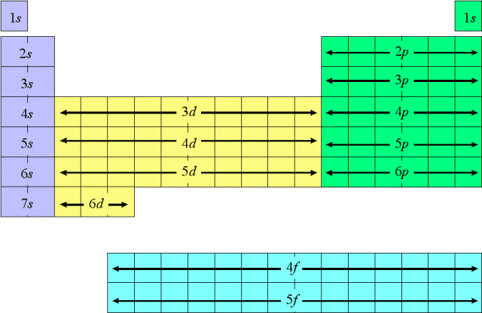
The form of the Periodic Table is closely related to the electron configuration of the elements
You can write the electron configuration using the Periodic Table as a guide

Slide 10
Examples:
Lithium
1s²2s¹
Nitrogen
1s²2s²2p³
Magnesium
1s²2s²2p⁶3s²
Sulphur
1s²2s²2p⁶3s²3p⁴
Argon
1s²2s²2p⁶3s²3p⁶
Manganese
1s²2s²2p⁶3s²3p⁶4s²3d⁵

Slide 11
Core Notation
The core of an atom is the set of electrons with the configuration of the nearest noble gas with an atomic number LESS than that of the element
To find the noble gas that represents the core look in the row above the element
Use the symbol of the noble gas in [ ] to represent the core electrons
Then write the configuration for the remaining electrons

Slide 12
Examples:
Manganese
1s²2s²2p⁶3s²3p⁶4s²3d⁵
Core Notation
[Ar] 4s²3d⁵
Try: Calcium
Silver
Lead

Slide 13
Valence Electrons
We can determine the number of valence electrons in an atom by looking at the electron configuration
Electrons in the core are not valence electrons
Electrons in filled d or f shells are not valence electrons
All other outer electrons are valence electrons

Slide 14
Start by writing the electron configuration using core notation
Chlorine: [Ne]3s²3p⁵
Count the number of electrons in the outer s and p orbitals
= 7 electrons
Count the number of electrons in any unfilled d and f orbitals
= none
The total number of valence electrons for chlorine is 7

Slide 15
Examples:

Slide 16
Ion Formation
Negative ion:
Start adding electrons to the last unfilled shell
Positive ion:
Remove electrons from the outer most shells first
Remove p electrons
Then remove s electrons
If necessary, remove d electrons

Slide 17
Examples:

